Slide 1
Presentation- Project 1
By: Freddie Boadu

Slide 2
Project overview
Introduction
Block Diagram
State Machine
Pitfalls and achievements

Slide 3
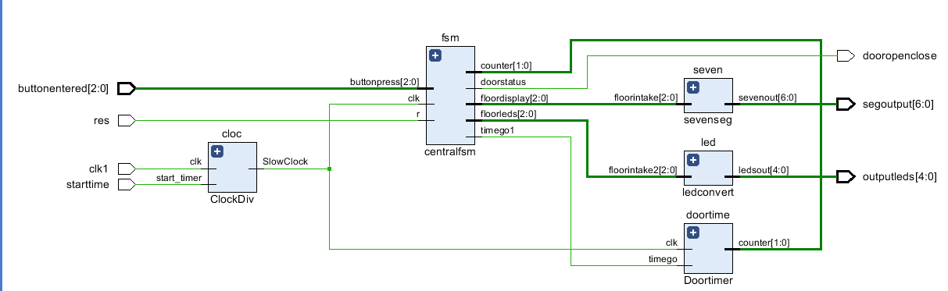
Block diagram

Slide 4
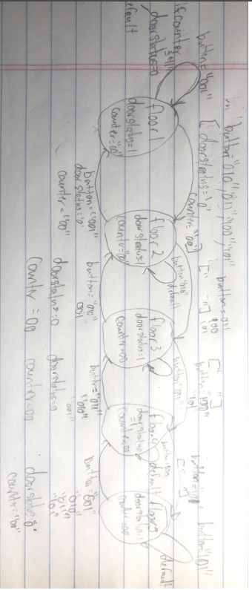
State machine

Slide 5
Pitfalls and Achievements
Learned how to do top design
Learned how to do FSM a lot better
Had trouble with the timer on my system
Learned how to work better during COVID in terms of communicating with professor for ideas.

Slide 6
Conclusion
The elevator project was a success
Only downside was the timer not fully working.

Slide 7

Questions

